Slide 1



Introduction to Tourism Management System
This tourism management system is designed to streamline the travel booking process, from trip planning to on-the-ground coordination. It offers a comprehensive suite of features to enhance the overall travel experience for both tourists and travel providers.
by Chetan Chauhan

Slide 2

Key Features of the System
1
Destination Management
2
Accommodation Booking
3
Transportation Coordination
Provides detailed information on popular tourist destinations, including attractions, accommodations, and transportation options.
Allows users to easily search, compare, and book a variety of accommodations, from hotels to vacation rentals.
Facilitates the booking and management of various transportation services, such as flights, trains, and car rentals.

Slide 3
Destination Management
Destination Profiles
Trip Planning Tools
Destination Recommendations
Comprehensive profiles on popular tourist destinations, including detailed information on attractions, cultural highlights, and local cuisine.
Intuitive tools to help users plan their itinerary, estimate travel costs, and access local weather and transportation information.
Personalized destination recommendations based on user preferences, travel interests, and past booking history.

Slide 4
Accommodation Booking
Diverse Options
Filtering and Sorting
A wide selection of accommodations, from 5-star resorts to budget-friendly hostels, to suit every traveler's needs and preferences.
Advanced search and filtering tools to help users find the perfect accommodation based on location, price, amenities, and reviews.
Secure Booking
User Reviews
Seamless and secure booking process, with flexible payment options and clear cancellation policies.
Genuine guest reviews and ratings to help users make informed decisions about their accommodations.

Slide 5

Transportation Coordination
1
Flight Booking
Book flights to and from your destination, with options to compare prices, schedules, and airline preferences.
2
Ground Transportation
Arrange for car rentals, taxi services, or local public transportation to get you around your destination.
3
Seamless Connections
Coordinate various modes of transportation to ensure a smooth and efficient travel experience.

Slide 6



Event Planning and Promotion
Event Scheduling
Promotional Tools
Collaborative Planning
Organize and manage events, from conferences to cultural festivals, with comprehensive scheduling and logistics tools.
Leverage digital marketing strategies to effectively promote events and attract attendees from around the world.
Facilitate seamless collaboration between event organizers, vendors, and participants to ensure a successful event.

Slide 7




Customer Relationship Management
Personalized Experiences
Tailor travel packages and recommendations based on individual preferences and past booking history.
Responsive Support
Provide prompt and attentive customer service through multiple communication channels, including phone, email, and live chat.
Loyalty Programs
Offer rewards and incentives to encourage repeat business and build long-term customer relationships.

Slide 8
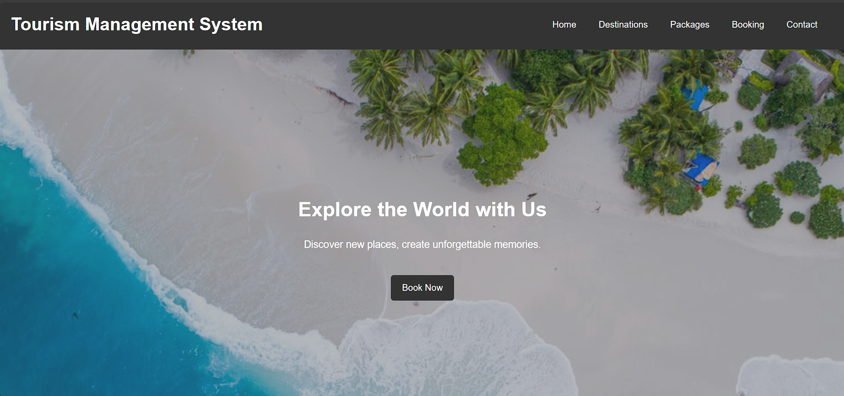

Slide 9
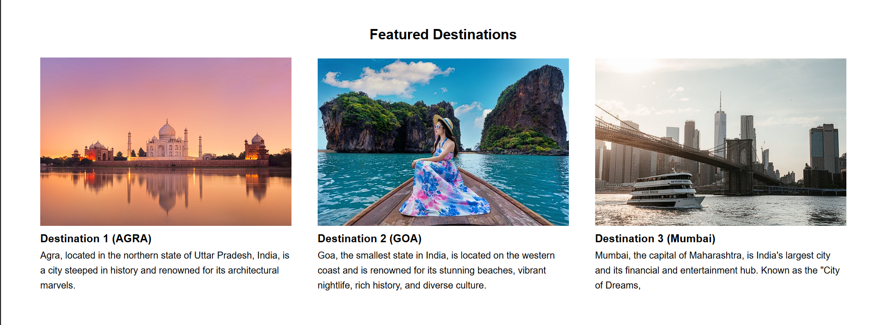

Slide 10
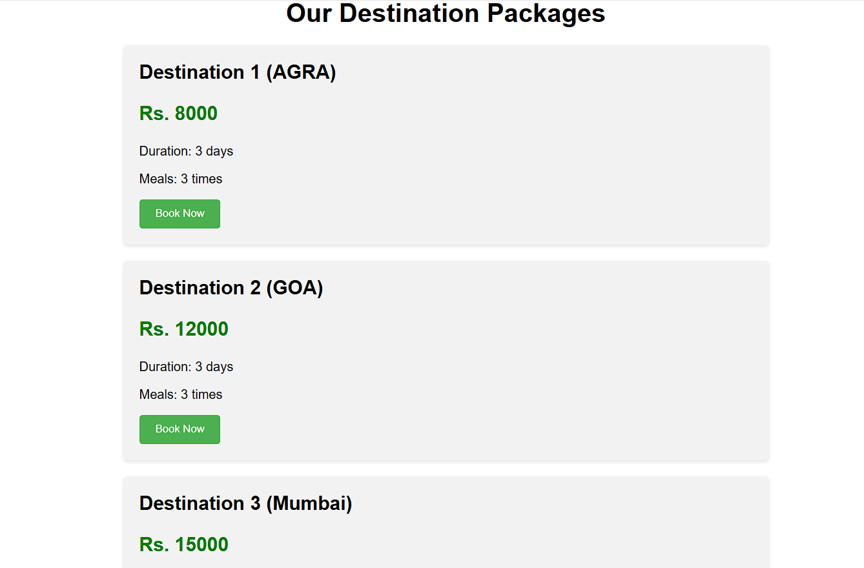

Slide 11
Conclusion and Future Developments
As the tourism industry continues to evolve, the Tourism Management System is committed to staying at the forefront of technological advancements. Future developments may include enhanced AI-powered recommendations, virtual reality experiences, and seamless integration with emerging travel technologies.

Slide 12
Thank You

